Slide 1
Welcome

Slide 2
Features:
1. Speech Recognition
2. Hand written to Digital text
3. Drawing board to object

Slide 3
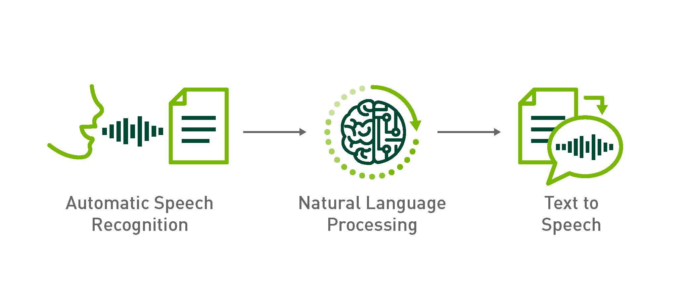
Speech Recognition

Slide 4
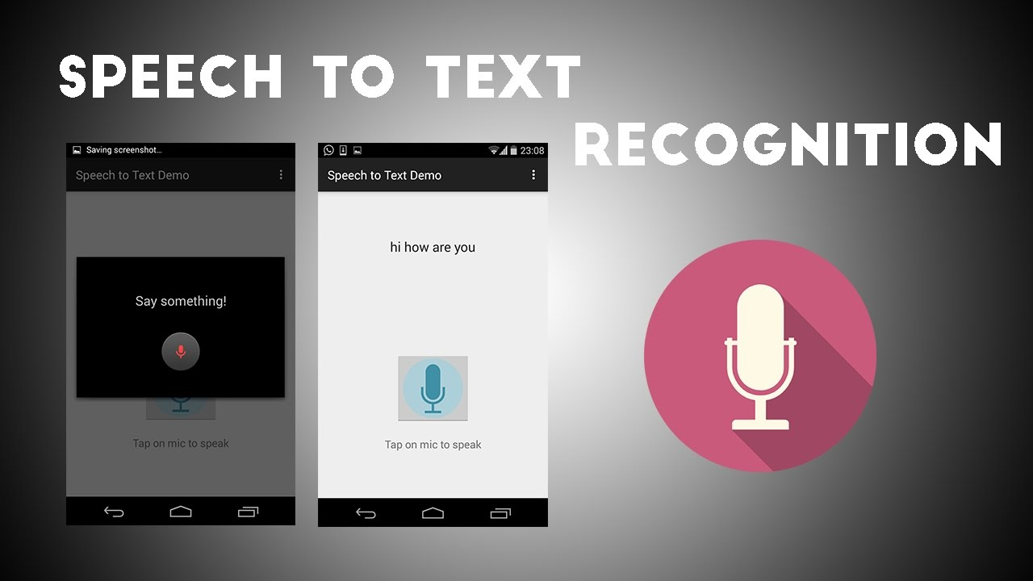
Speech Recognition

Slide 5
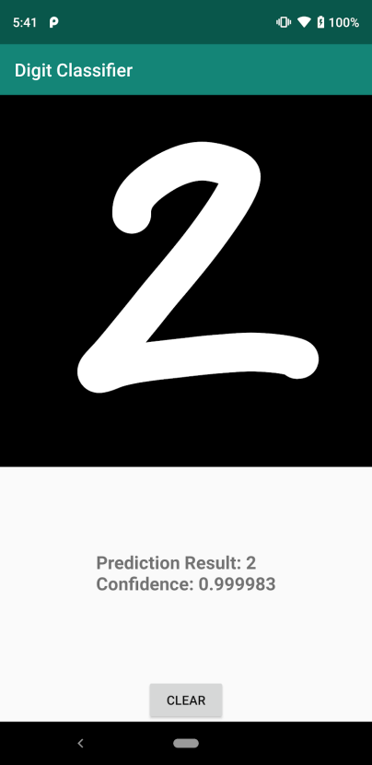
Hand Written to Digital Text

Slide 6
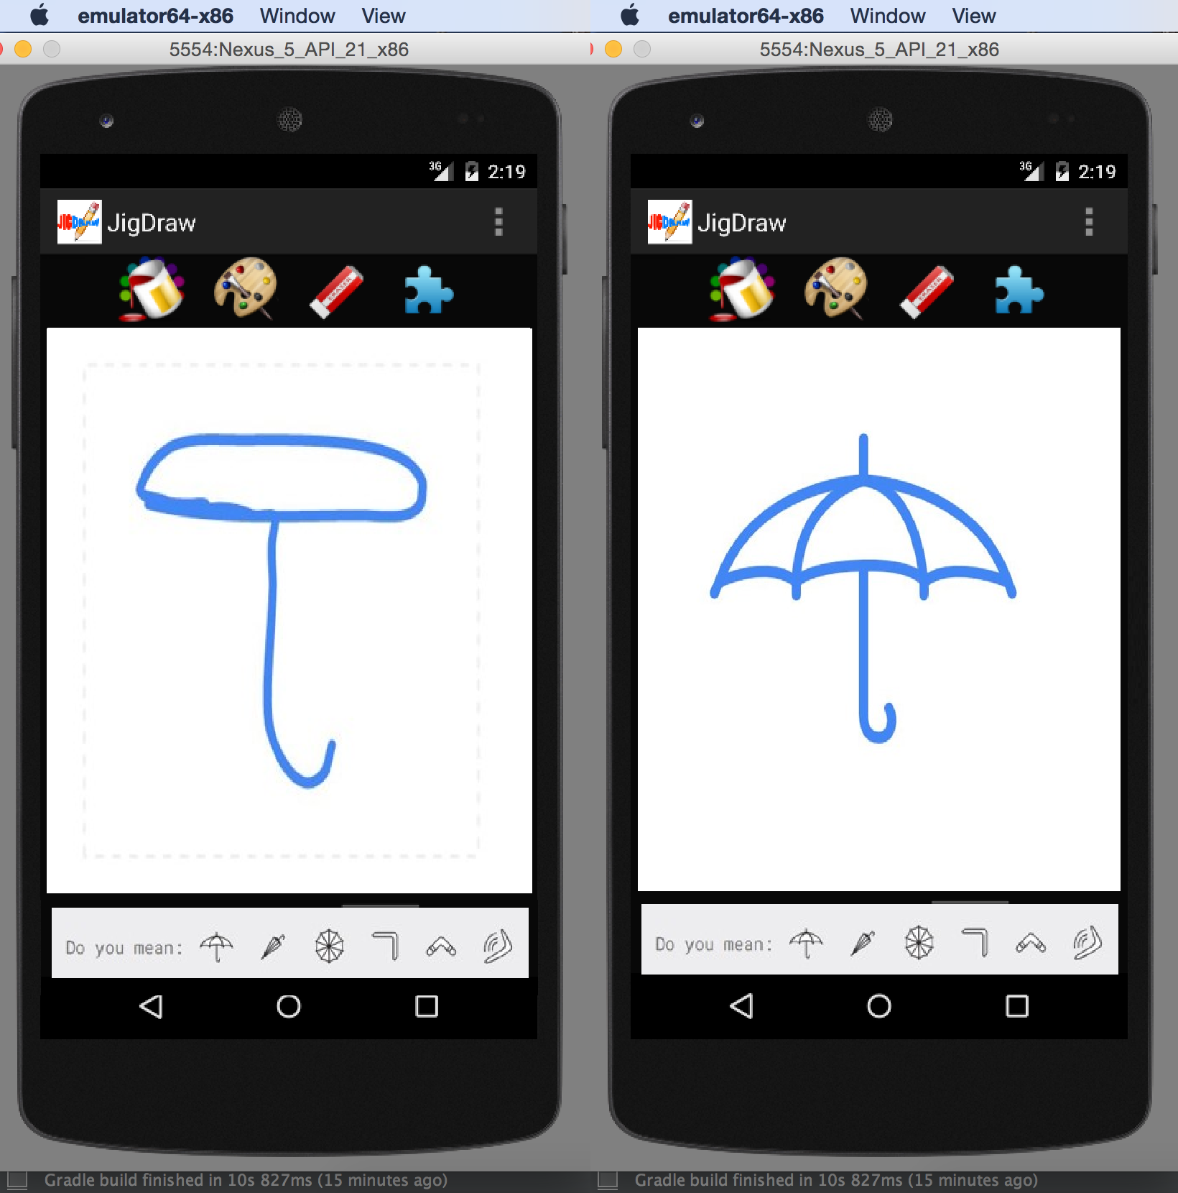
Drawing Board to Object

Slide 7
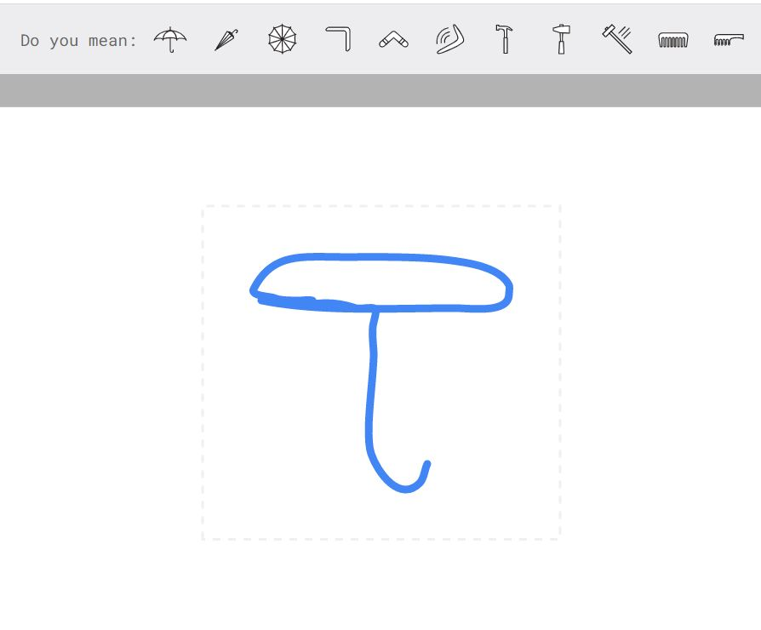

Drawing Board to Object

